Slide 1
LATTER DAY SAINT THEOLOGY
-AN OBJECTIVE ANALISIS ON LDS DOCTRINE-

Slide 2
DO LDS MEMBERS AGREE IN…
VIEWS ON THE TRINITY

Slide 3

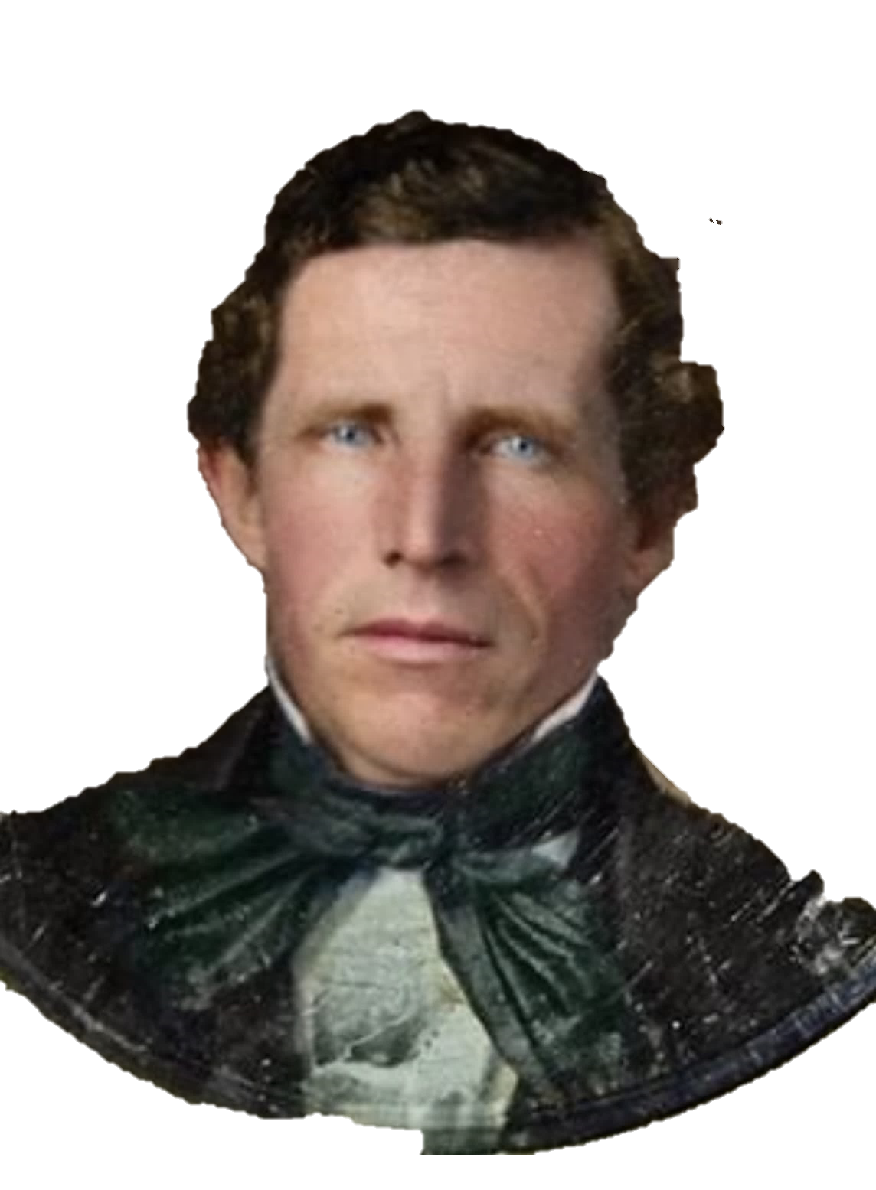
“I have always declared God to be a distinct personage, Jesus Christ a separate and distinct personage from God the Father, and that the Holy Ghost was a distinct personage and a Spirit: and these three constitute three distinct personages and three Gods”
- (Joseph Smith, “History of the Church”, 6:474).
LDS Church Doctrine, denies the existence of a Trinity or unity between Jesus, God, and The Holy Spirit.
Instead, their aproach is a heirarchy of Gods who are joined in purpose, which is to guide the “Latter Day Saints” in their way back to the Father´s presence.

Slide 4

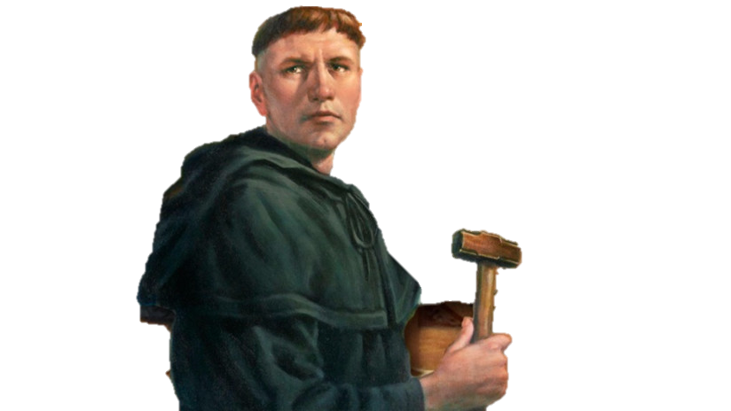
“I believe in Jesus Christ, His only Son our Lord, Who was conceived by the Holy Spirit; […] I believe that Jesus Christ is true God, begotten of the Father from eternity, and also true man, born of the Virgin Mary; and that He is my Lord, Who has redeemed me, a lost and condemned creature”
- (Dr. Martin Luther, “Small Catechism”)
This doctrines is very deep rooted intro Christianity, such way, even after the protestant reformation, the doctrine was still a very well accepted. By early protestants (Lutherans).

Slide 5
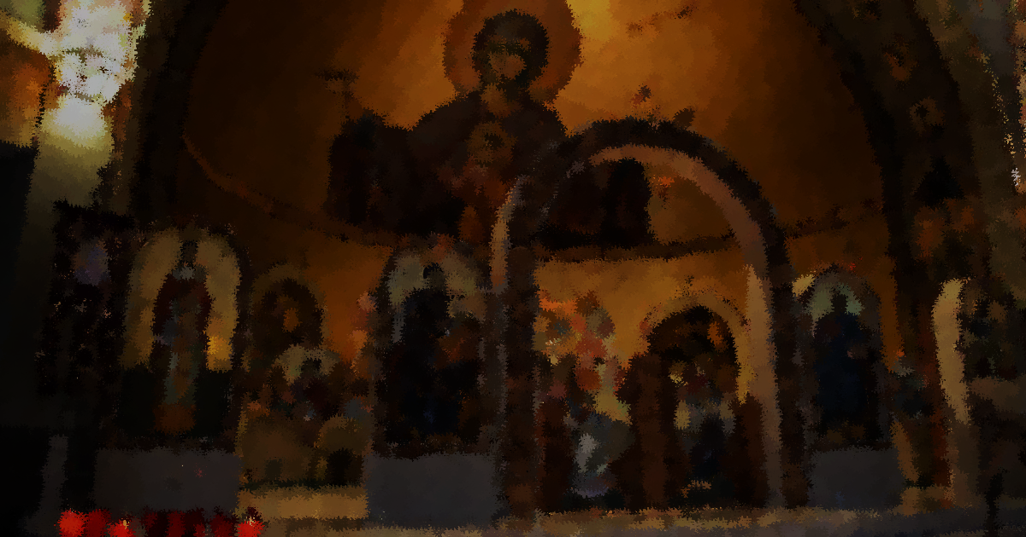
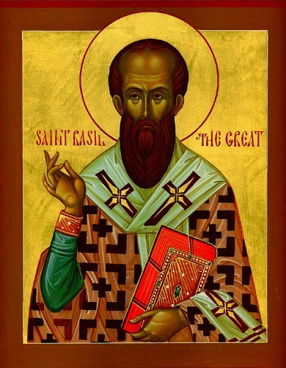
“[…] we don’t believe in the traditional concept of the Trinity. We believe that the Father, the Son, and the Holy Ghost are three separate beings who are one in purpose.”
(LDS Online Manual, “Do Members of The Church of Jesus Christ of Latter-day Saints Believe in the Trinity?”)
The Trinity doctrine dates way back to the church origins. The Trinity´s complex nature was often subject for confusion, as a result, doctrines like Tritheism (Doctrine that claims God, Jesus, and Holy Spirit are three separate gods) where often preached, because of it, Church fathers like St. Basil, addressed the issue.
"We do not speak of three gods, as though they were individuals who share a common nature like three men. For the Godhead is one and the same, and the persons of the Trinity are distinct but not separate, sharing the same essence without division. “
(On the Holy Spirit, Chapter 18, 45), II Century AD.)

Slide 6
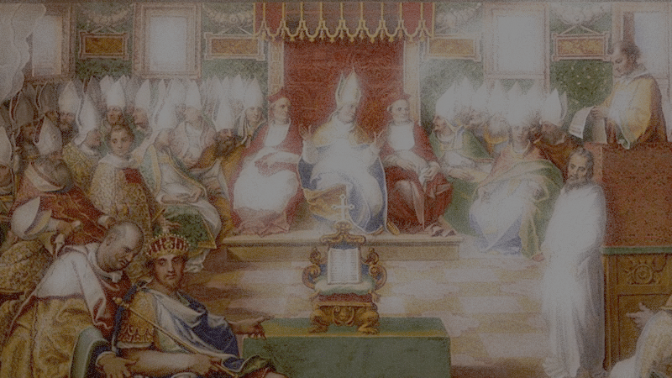
TRINITARIAN MODEL
UN-NAMED GOD
ETERNALY IS…
The Trinity affirms, God is three persons, who are different from eachother, yet they are still the same God of Israel.
God was, is, and will forever be the Father, the Son, and the Holy Spirit.
ETERNALY IS…
ETERNALY IS…
FATHER
YHWH
ETERNALLY
CO-EXIST WITH…
SON
JESUS
HOLY SPIRIT

Slide 7
TRINITARIAN MODEL
FATHER
YHWH
However, even though God is the three, the three are not each other.
Each person of the Trinity is different from each other, without interrupting the ever-existent bond that joins them.
IS
IS NOT…
UNAMED GOD
IS NOT…
SON JESUS
IS
IS
HOLY SPIRIT
IS NOT…

Slide 8
LDS TRITHEISM
UN-NAMED GOD
CREATED AND GLORIFIED…
LDS prophet, Joseph Smith, affirms God is a glorified being who once was a human like his children, because he is not eternal (meaning he had a begining) he is bind to matter, and the laws of the universe. Elohim is not the creator of creation, but a glorified man.
FATHER
ELOHIM
CREATED AND GLORIFIED…
SON OF GOD
HOLY GHOST

Slide 9
LDS TRITHEISM
UN-NAMED GOD
FATHER
“ELOHIM”
Elohim became a god because he followed his god’s commandments. Because angels are glorified man or pre-existent souls, Jesus and Satan are brothers, both created by Elohim.
Now this shows up another mayor difference, and that is God’s eternal nature.
SON OF GOD
HOLY GHOST
SATAN

Slide 10
DO LDS MEMBERS AGREE IN…
ETERNAL EXISTENCE OF GOD

Slide 11
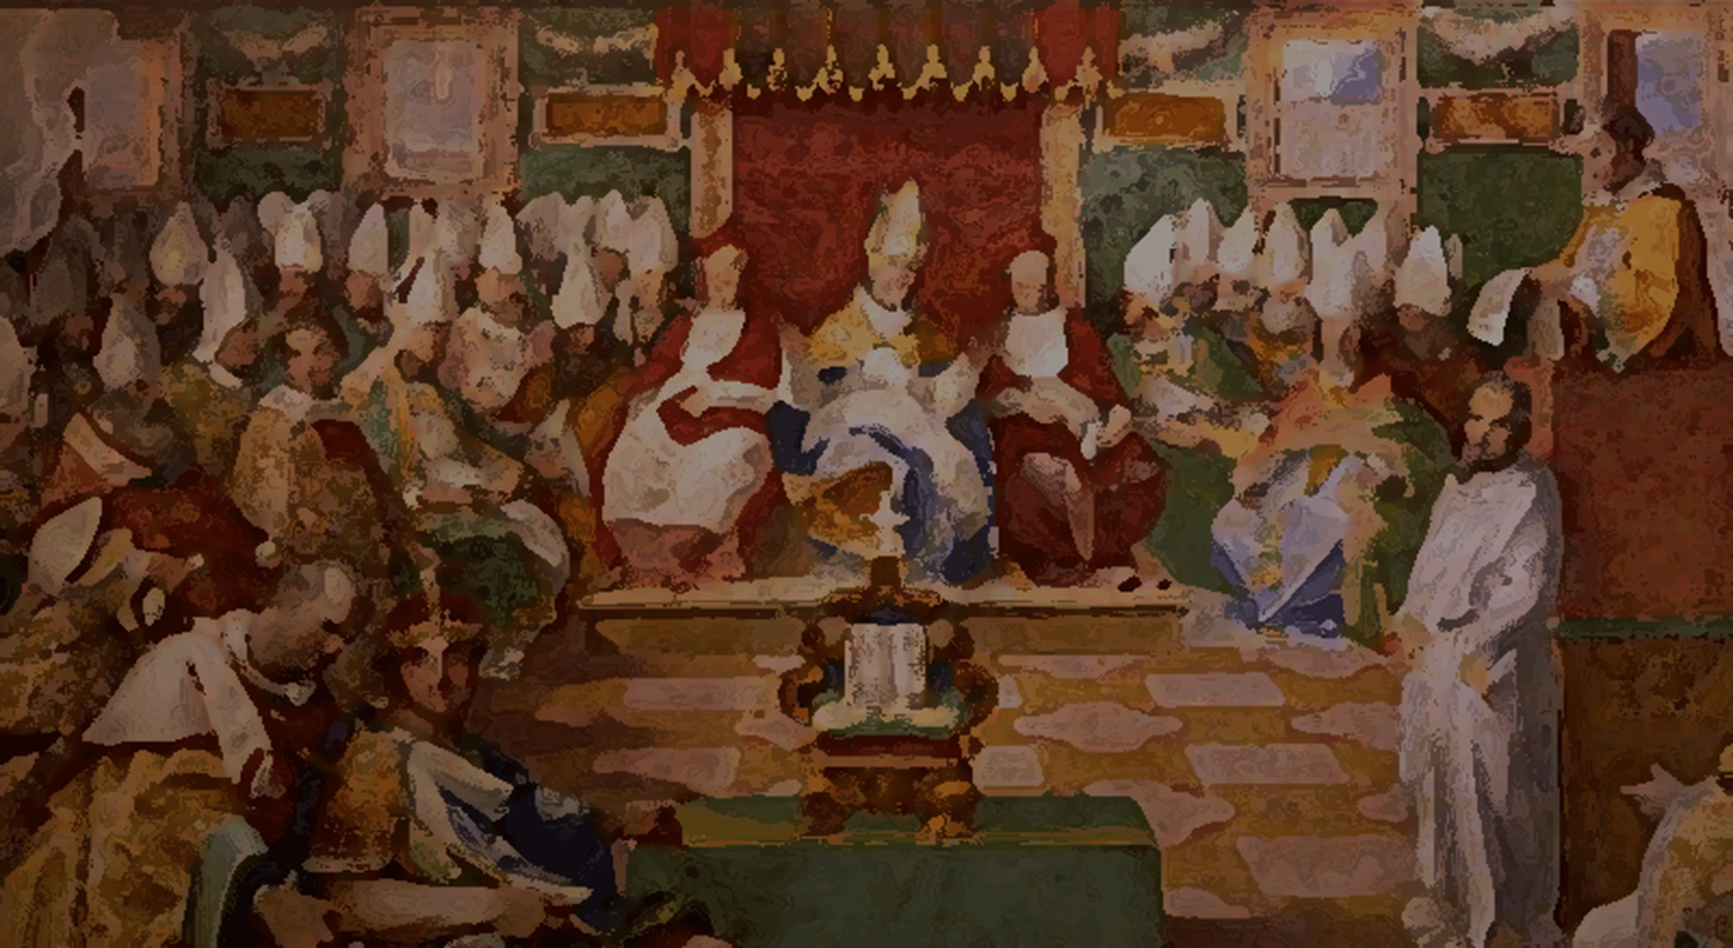
LDS TRITHEISM
“God himself was once as we are now, and is an exalted man, […] He was once a man like us; yea, that God himself, the Father of us all, dwelt on an earth, the same as Jesus Christ Himself did”.
(Joseph Smith, “Minutes and Discourses, 6–7 April 1844, as Published in Times and Seasons”)
UN-NAMED GOD
CREATED AND GLORIFIED…
As stated before in page 8, “LDS theology, affirms God is a glorified being who once was a human, […] he is not eternal (meaning he had a begining) […] Elohim is not the creator of creation, but a glorified man.“
This theology resambles arianism, which teaches as following:
FATHER
ELOHIM
CREATED AND GLORIFIED…
“If the Father begat the son, he that was begotten had a beginning of existence, hence it is clear that there was a time when the son was not. […]”
(Arius, “Arianism”, II – III Century AD)
SON OF GOD
HOLY GHOST

Slide 12
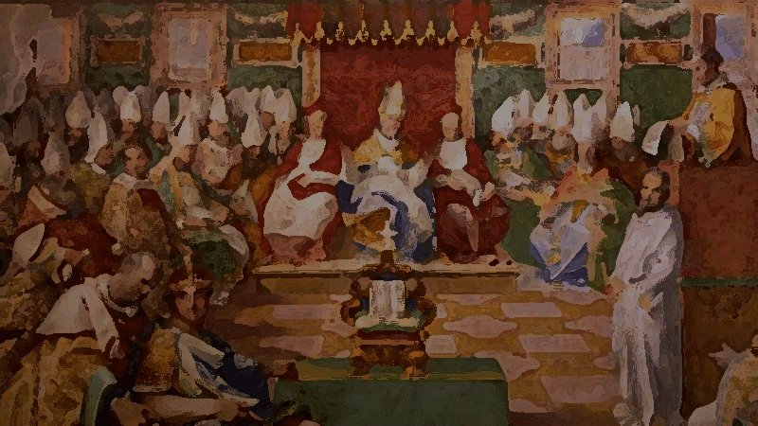

This is a problem for many Christians because Arian christology is condemned as heresy for it denies Jesus nature to be “immutable and self-existent”, in other words, eternal.
“Arianism, Christian heresy that declared that Christ is not truly divine but a created being. According to the Alexandrian presbyter Arius (4th century), God alone is immutable and self-existent, and the Son is not God but a creature with a beginning.“
(Britannica, “Beliefs and controversy of Arianism”)

Slide 13
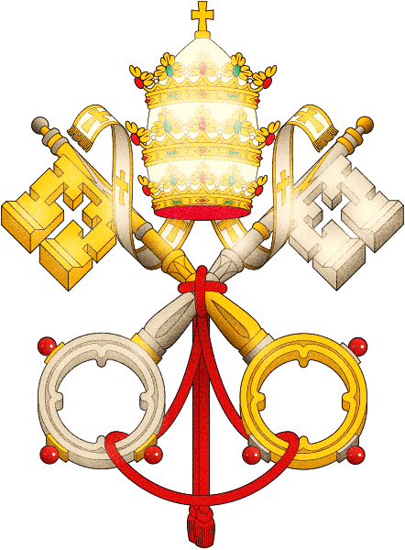

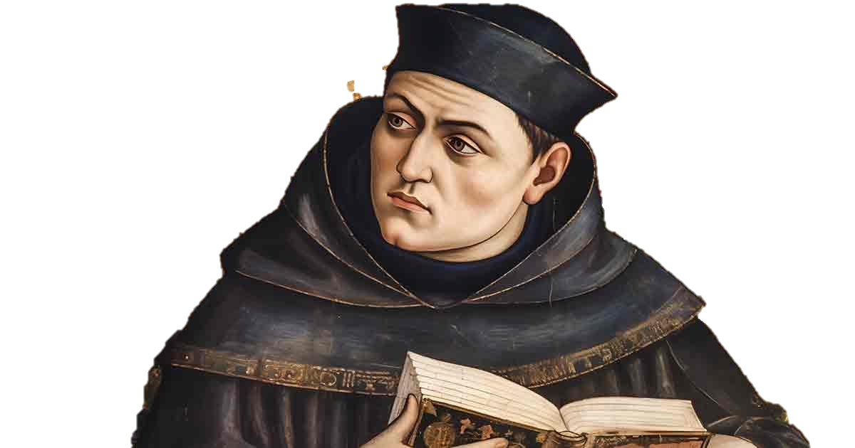
“The doctrine of a Heavenly Mother is a cherished and distinctive belief among Latter-day Saints.
While there is no record of a formal revelation to Joseph Smith on this doctrine, some early Latter-day Saint women recalled that he personally taught them about a Mother in Heaven.”
(Gospel Topic Essays, “Heavenly Mother”)
509 Mary is truly "Mother of God" since she is the mother of the eternal Son of God made man, who is God himself.
511 The Virgin Mary "co-operated through free faith and obedience in human salvation" (LG 56). She uttered her yes "in the name of all human nature" (St. Thomas Aquinas, S Th III, 30, 1). By her obedience she became the new Eve, mother of the living.

Slide 14
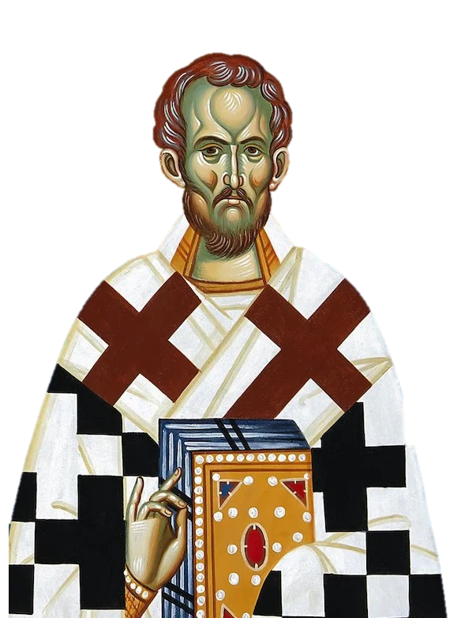
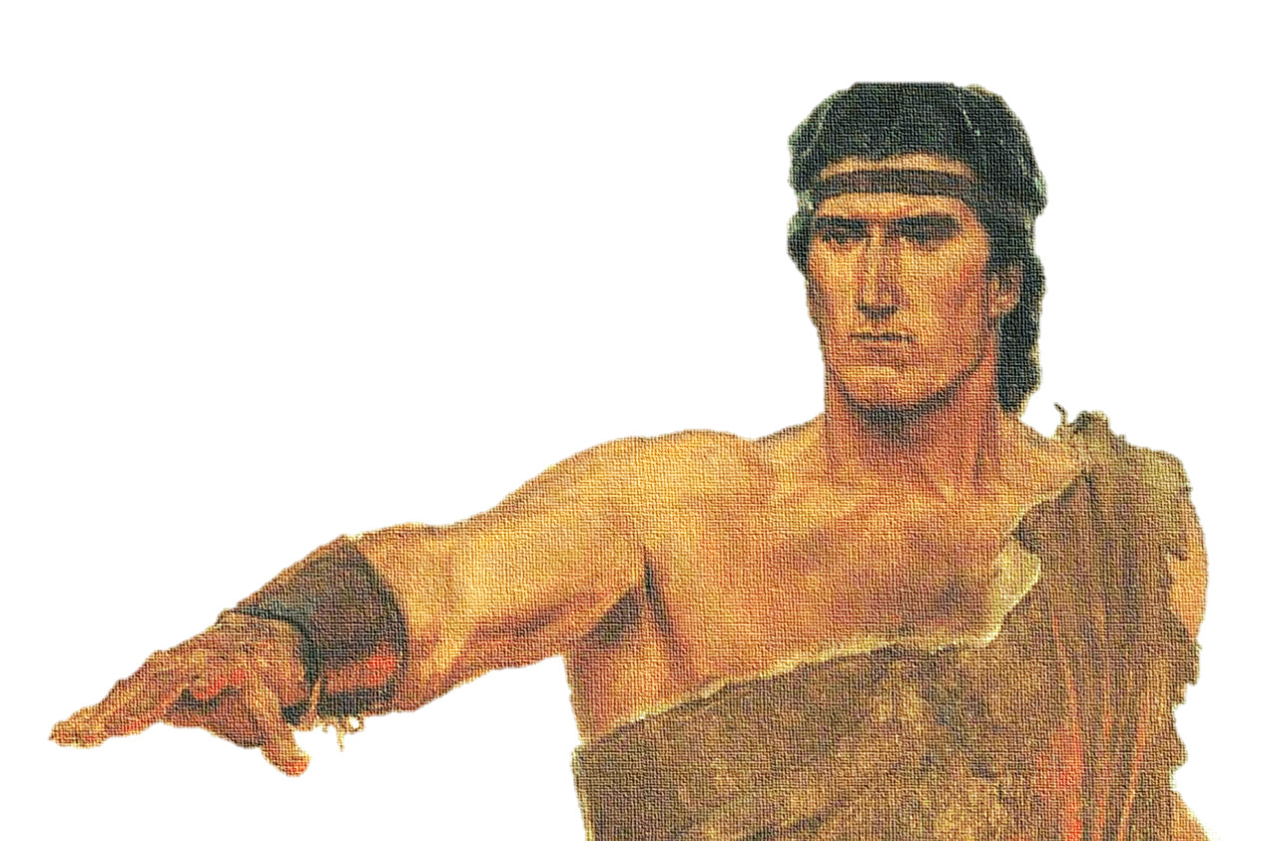
“25 Adam fell that men might be; and men are, that they might have joy.
26 And the Messiah cometh in the fulness of time, that he may redeem the children of men from the fall.”
(Latter Day Saits, “Book of Mormon”, 2 Nephi 2:25-26)
“[…] The fall of Adam was a rebellion against the Creator, and through disobedience, sin entered the world. This act of disobedience brought corruption to both body and soul, but God, in His infinite mercy, sent His Son to restore what Adam had lost.“
(The City of God, Book XIII, Chapter 14)

Slide 15
